Slide 1
DFD Numbering System
Course text uses EV (Event) numbers – we use processes and a simple numbering system
Level 0 – 0
Level 1 – 1, 2, 3, 4, 5 .. N
Level 2 – 1.1, 1.2
Level 0 – Use <Name> System.
At levels 1..n – try to always use a strong Verb Noun Phrase that explicitly identifies the transformation to be performed on the data – i.e. Process Data means nothing – actually, it means that you don’t understand the problem you are trying to solve.

Slide 2
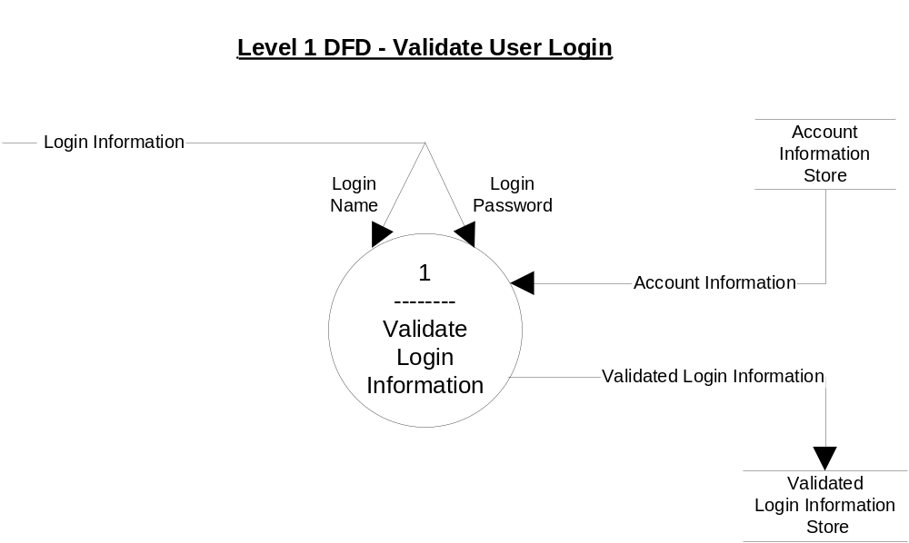

Slide 3
WHAT Must The Software Do To Validate Login Information?
Several approaches may be taken:
Use the use-cases and their TSDs (if they are available) as a starting point, which this example is doing.
Use Structured English (Course Text pages 352 – 355) to specify the underlying logic of elementary processes in the DFDs
Use a decision table to model a set of conditions and their corresponding actions
Draw the logical flow of data using DFDs, and then create the Structured English description

Slide 4
Problems with Natural English
Natural English is too often imprecise and frequently subject to interpretation (and misinterpretation):
We overuse compound sentences Consider the following procedure: “Remove the screws that hold the outlet cover to the wall. Remove the outlet cover. Disconnect each wire from the plug, but first make sure the power to the outlet has been turned off.” An unwary person might try to disconnect the wires prior to turning off the power!
Compound conditions tend to show up in natural English. For example, if credit approval is a function of several conditions: credit rating, credit ceiling, annual dollar sales for the customer in question, then different combinations of these factors can result in different decisions. As the number of conditions and possible combinations increases, the procedure becomes more and more tedious and difficult to write.

Slide 5
Structured English
Both a language and syntax, based upon relative strengths of structured programming and the natural English language
Some of us write everything like it was a program. If business procedures required such precision, we’d write everything in a programming language.
Not pseudocode! It does not concern itself with declarations, initialization, linking, and other technical issues.
Use the language of the business you are modeling so that your client, your team members, and your boss understands the analysis that you are performing.

Slide 6
Structured English Constructs
See Text pages 353 – 356
Sequential
Simple, declarative sentences – one after another. Compound sentences are discouraged because they frequently create ambiguity
Each sentence uses strong action verbs that are understandable to the users – Get, Find, Record, Create, Read, Update, Delete, Calculate, Write, Sort, Merge, and so on.
A formula may be included as part of a sentence.

Slide 7
Structured English Constructs
Conditional or Decision Structure
If-then-else
One set of steps should be taken if a specified condition is true, but a different set of steps should be specified if the specified condition is false.
Case
Used when there are more than two sets of steps to choose from.
Used to replace a convoluted If-then-else, if-then-else, if-then-else structure

Slide 8
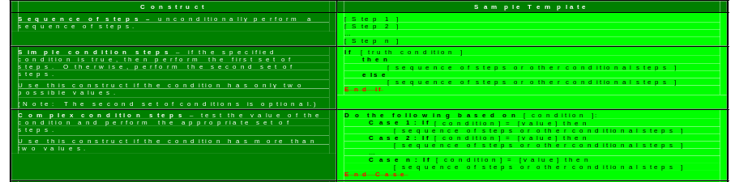
Structured English Constructs (Part 1)

Slide 9
Structured English Constructs
Iteration or Repetition Structure
Do-While, While
Certain steps are repeated zero, one, or more times based on the value of the stated condition.
Question! When is Do-While used versus While?
Repeat-Until
Certain steps are repeated one or more times based on the value of the stated condition.

Slide 10
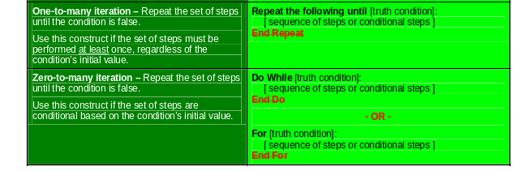
Structured English Constructs

Slide 11
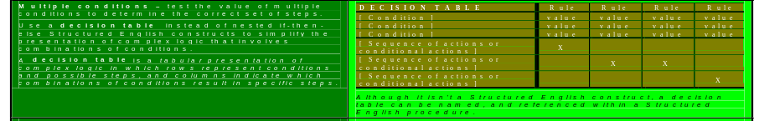
Structured English Constructs
complex logic in which rows represent conditions

Slide 12
Process One – Validate Login Decision Table
Conditions and Actions | Rule 1 | Rule 2 | Rule 3 | Rule 4
Conditions
Login Name | Matches User Name | Matches User Name | Matches User Name | Does not match User Name
Login Password | Matches User Password | Matches User Password | Does not match User Password | Doesn’t matter
Type of User | Cashier | Administrator | Doesn’t matter | Doesn’t matter
Actions
Display Login GUI |  |  | X | X
Display Count Currency GUI | X
Display Manage Accounts GUI |  | X
Write Validate Login Information to Validate Login Information Store | X | X

